Slide 1

Approaches for studying Anatomy
Dr. Bip Choudhury
Bipasha.Choudhury@manchester.ac.uk

Slide 2
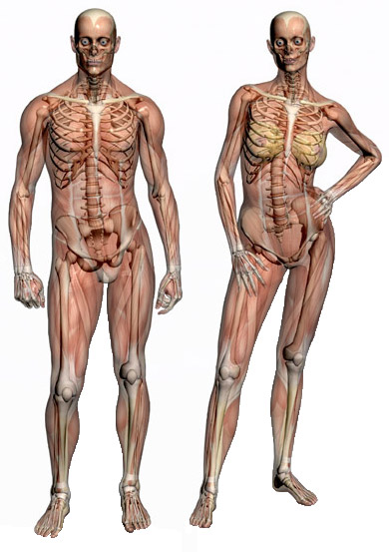
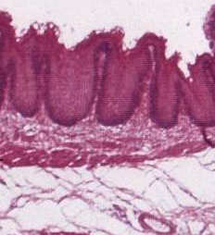
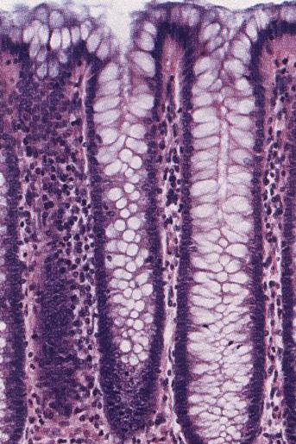
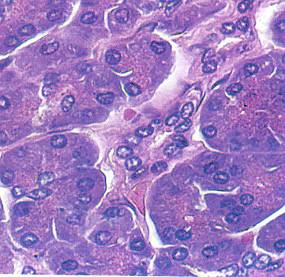
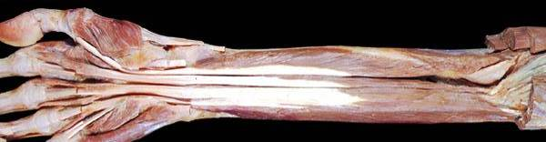
Functional anatomy
Gross anatomy
Microscopic anatomy (histology)

Slide 3

Components of your anatomy studies
Learning Agendas
Tutorials
Dissecting room sessions
Workbooks (for consolidation)
Virtual resource areas
Histology sessions
Complete anatomy
Acland videos

Slide 4
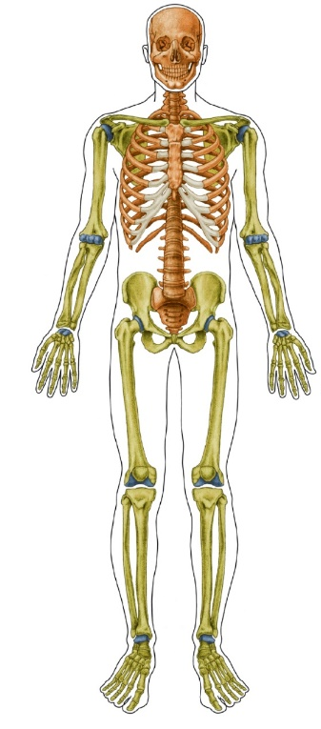
Introduction to Medicine - Anatomy Sessions
Read Introduction to Anatomy - located on OneMed in the Introduction to Medicine section
Go to 1med Learn
→ Year One
→ Introduction to year 1
→ Welcome week
→ Anatomy – Introduction to Anatomy & Code of conduct
Welcome week - Introduction & tour of dissecting room
Week 1 – Tutorial - Neuromuscular systems
Week 2 – Tutorial - Skeletal system
Week 3 (Theme 1A) - DR session – neuromuscular and skeletal systems
Sessions led by Clinical Teaching Fellow (CTF)
Interactive – be prepared to join in
Consolidate your knowledge and review your understanding by completing the workbook located on onemed in the Introduction to Medicine pages, Theme 1A

Slide 5
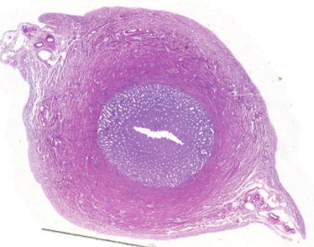
Histology in the introduction to medicine weeks
Basic Tissues lecture 1/10/24
Histology Videos
  Epithelium & Connective Tissues 1
  Epithelium & Connective Tissues 2
  Epithelium & Connective Tissues 3
Directions to view slides in your own time
Check understanding by answering questions

Slide 6
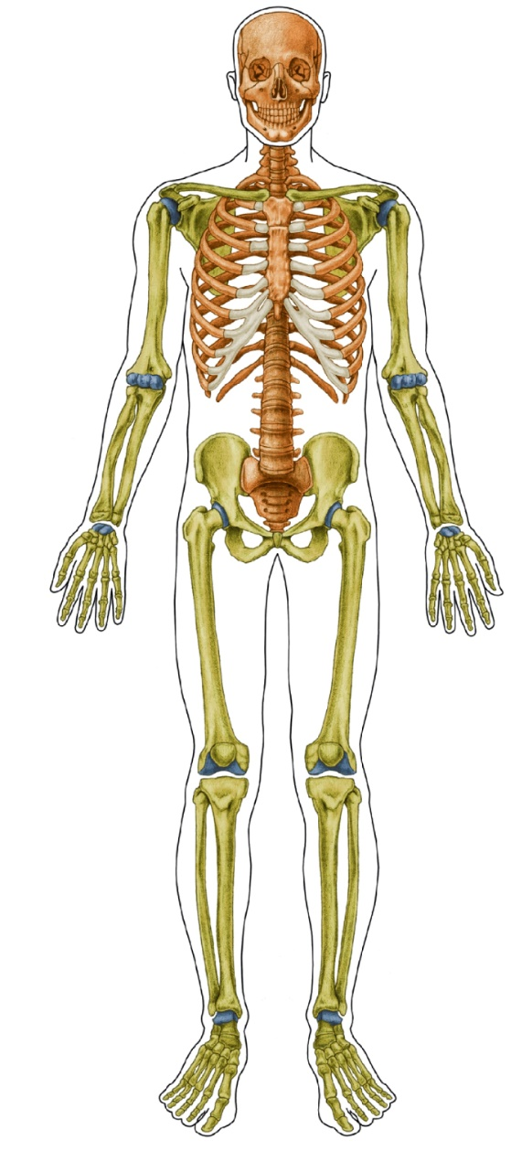
Semester 1 anatomy sessions
Tutorial
Led by your Clinical Teaching Fellow
Interactive session to check your understanding of topic
Dissecting room session
Examine relevant specimens
Dissection as appropriate

Slide 7

Ground rules for anatomy classes
Be prepared – do the recommended reading before the session
These are interactive sessions
  Join in
  Answer questions
  Test your understanding
  Allows anatomy demonstrator to clarify any misunderstandings
Don’t be afraid to
  Ask questions
  Get things wrong
Tutorials - arrive on time as late comers will be marked absent
DR sessions
  Arrive 10 minutes early to allow time to put things in lockers and put on your lab coat
  Ensure that you are marked in as you enter the DR - It is your responsibility– if you fail to do so you will be marked absent and you will NOT be allowed to sign in retrospectively
  Late comers will be marked absent
Enjoy and have fun

Slide 8

Online Anatomy Resources
Complete anatomy
Download the free version from the App Store for your compatible device
Complete the in-app registration process using their university email address w/required email domain
Navigate to Settings > My Account and enter the Activation Code into the redeem code area.
Activation code 284177628319
Acland’s anatomy videos
  Directed to relevant videos each week
  On campus access – www.aclandanatomy.com
  Off campus access via VPN

Slide 9

Clinical Key
Provides online free access to numerous texts useful for your studies in medicine
Search browser – ClinicalKey student
On the login page select Login via your institution
Search for the institution name by typing in Man and the option University of Manchester will appear

Slide 10
Anatomy & Histology Texts
Moore et al, Clinically Orientated Anatomy
  Available as an ebook on Onemed Learn
Gosling et al. Human Anatomy: Colour Atlas and Textbook
  Available on Clinical Key
Mitchell, Histology: An Illustrated Colour text
  Available on Clinical Key
Young & Heath, Wheater’s Histology
  Available on Clinical Key
Snell – Clinical Anatomy (not available online)
Any other anatomy and histology books

Slide 11
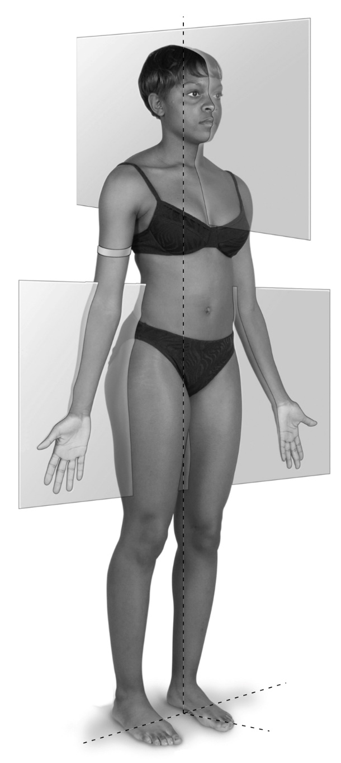
Why is it important to know your anatomy?
Knowledge of anatomy is essential for all areas of medicine
You can’t fix something that is broken if you don’t know what the normal structure is
You can’t usually see what is inside the body, so you need to be aware what underlies the skin
Mistakes can be made if you don’t know your anatomy

Slide 12
Anatomy studies
When first studying anatomy, it seems difficult because
  it feels like a different language
  lots of facts/information to remember
  It takes up a lot of your time
How should I approach this subject?
  Learn the terms on the anatomical terminology sheets
  Look up any new words that you come across
  Revisit the same topic several times in different ways
  Draw diagrams of structures, pathways (nerves & blood vessels etc)
  Be logical and link facts (this will become easier with time)
  Take the time and don’t give up

Slide 13



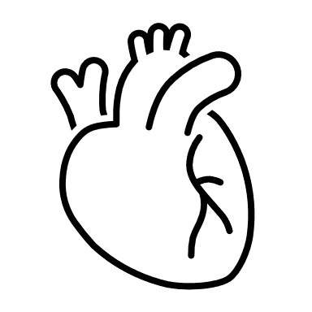




Revisit the topic several times in different ways
Recommended reading
Anatomy tutorials
Dissecting room session
Virtual resource area
Complete Anatomy
Flash cards
Anatomy wrap-up

Slide 14
Anatomy Learning Agenda for Theme 1
Female reproductive system 1
Learning Outcomes
At the end of your studies this week you should be able to:
Define the terms pelvis, pelvic girdle, pelvic cavity, true pelvis, false pelvis, pelvic inlet and pelvic outlet.
Describe the gross structure of the bones and joints of the pelvic girdle.
List and identify the organs of the female reproductive system and describe their gross anatomy (including relations, position, innervation, blood supply & lymphatic drainage).
Describe the microscopic anatomy of the ovaries, fallopian tubes, uterus & vagina
Recommended Reading
Before you attend your anatomy sessions you are advised to read the following sections in Chapter 6 Pelvis and Peritoneum of Moore et. al. (2018) Clinically Orientated Anatomy (or similar sections in your chosen anatomy textbook)
Pelvic Girdle (bones & features, orientation, joints and ligaments) Pages 554-565
Pelvic Viscera (Female internal genital organs - ovaries, uterine tubes, uterus and vagina) Pages 609-618
Acland's videos
Acland’s Video of Human Anatomy
Volume | Topic | Section | Length (mins)
3. Trunk | Musculo skeletal structures of the abdomen | Upper parts of the bony pelvis | 5.22
Anatomy Tutorial
This interactive session will allow you utilise what you have learnt in an interactive way. The session will be led by your anatomy demonstrator who will answer any queries and clarify any misconceptions.
Dissecting room session
In the dissecting room you will examine the specimens and models of the female pelvis and the bony pelvis. Use this time to reinforce your understanding of the topic.
Virtual Resource Area
This week’s virtual resource area will test your understanding of the bony pelvis and the female organs of reproduction
Histology
Reinforce what you learnt in the lecture by examining the following slides
Pre-adolescent ovary RF10
Ovary RF5

Slide 15

Tutorials
Interactive sessions – do the recommended reading before the session
Each week you will carry out 2-3 activities based on the content of the week
Designed for you to appreciate how much you understand and to identify where you are having difficulties
You are not being tested, this is an opportunity to apply your knowledge and reinforce your understanding
The sessions should be fun and enjoyable whilst aiding your learning
Tutor present to provide support, address misconceptions, explain difficult concepts

Slide 16
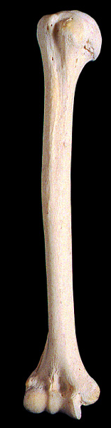
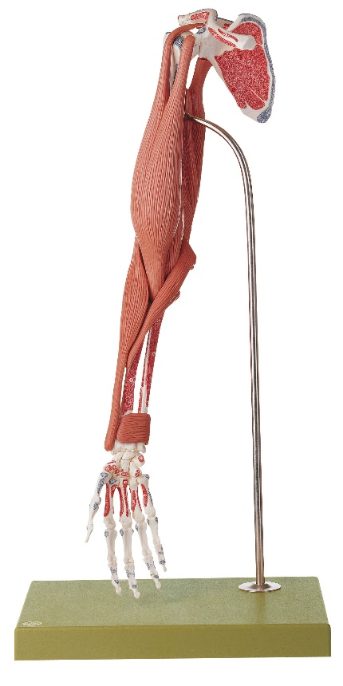
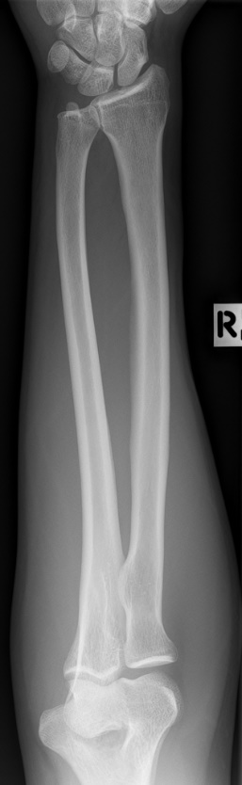
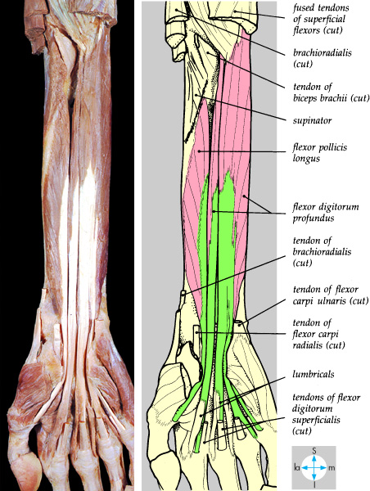
Dissecting room sessions
Examine prosections, bones, models and images in 3D to gain a greater understanding of their structure
Carry out dissection of the upper limb
iPad directions will direct and give guidance on what to look for
Tutor present to help you, answer your questions and go over difficult concepts

Slide 17
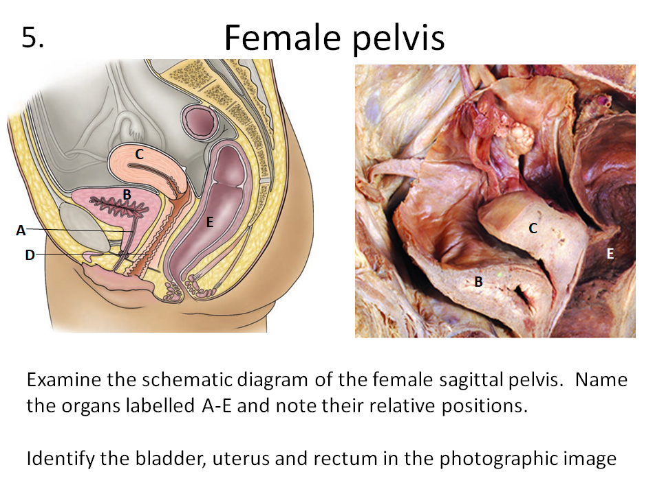
Virtual resource area
Series of images with questions related to current topic
Use any time during the week to check understanding

Slide 18
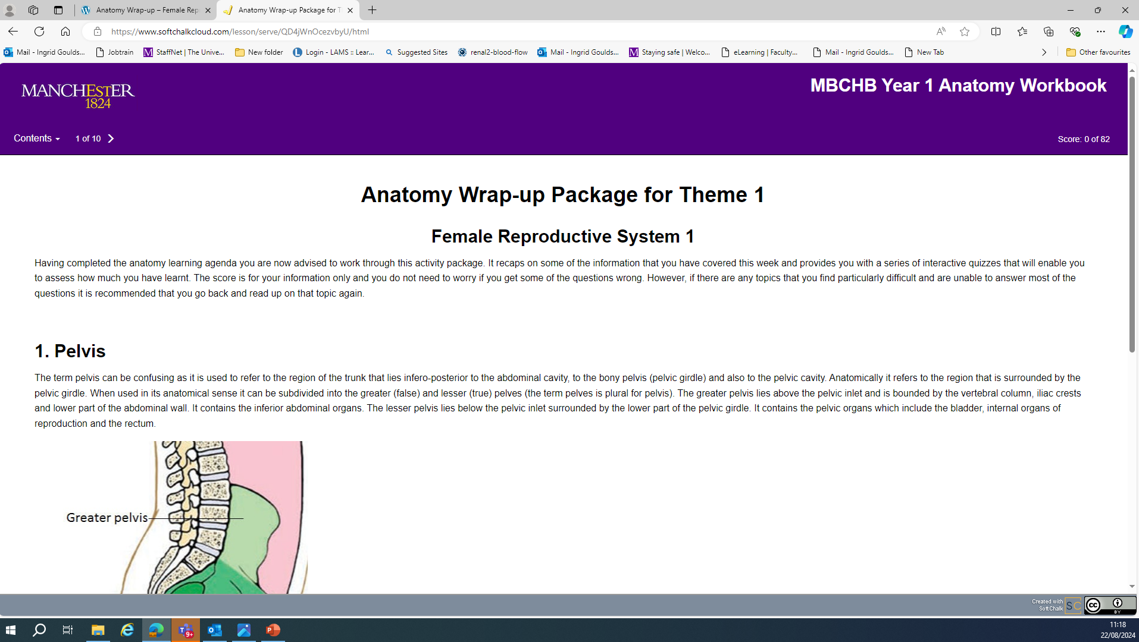
Wrap-up resource
Available at the end of the week (Friday)
Series of online activities which allow you to check your understanding and identify areas that require further study
You will see a mark, but these will not be seen by anyone else

Slide 19
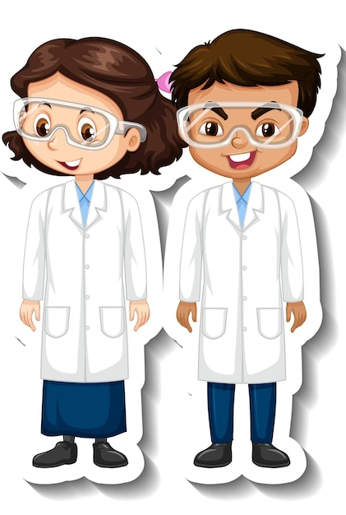

Helpful advice
Do the recommended reading before your anatomy sessions so that you can
  Participate in the tutorials and get more out of them
  Make the most of the dissecting room
  Ask the tutors about concepts that you find difficult and don’t understand
Anatomy becomes easier with time (and repetition), put in the time as it will benefit you throughout your career
Enjoy your studies and the “light bulb” moments when things start to click

