Slide 1

Introduction to the Dissecting Room and the Human Tissue Act 2004
Dr. Bip Choudhury
Bipasha.Choudhury@manchester.ac.uk

Slide 2
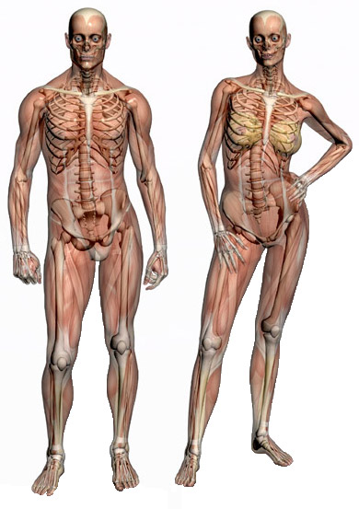
Why study Anatomy?
A sound understanding of anatomy is essential in order that you develop into a safe medical practitioner
You need to appreciate the structure of the body in order to diagnose and treat patients
You will have more confidence examining patients and images when you know what lies under the skin

Slide 3
Anatomy studies
Seems to be lots to learn and therefore time consuming
Invest the time, don’t be put off
You will be provided with appropriate resources
One of the most valuable resources will be your studies in the dissecting room

Slide 4
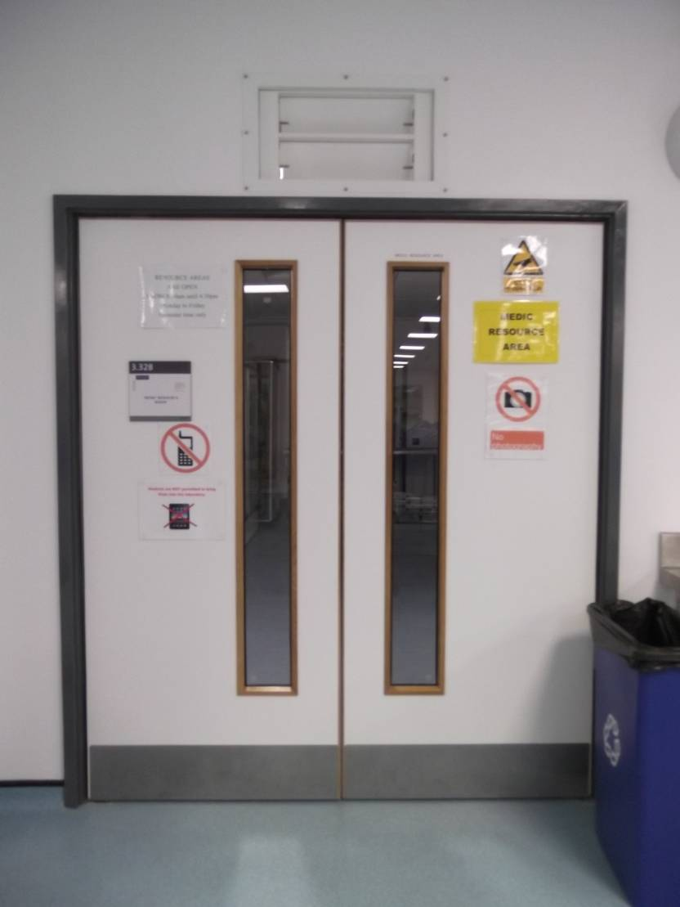
The Manchester Dissecting room
You will have the privilege of being able learn anatomy by working with human tissues; examining prosections and dissecting cadavers
This is only possible as some very special individuals have left their bodies to The University of Manchester so that you can get a better understanding of anatomy

Slide 5
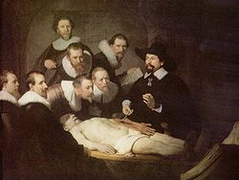
Our Body Donors
Body Donors
Bequeathal system
Consent
Retention of body parts
Memorial service
Individual funeral
The activities carried out in the dissecting room are carried out under the regulations of the Human Tissue Act 2004

Slide 6
Human Tissue Act 2004
Regulates actions concerned with the removal, storage, use and disposal of human tissues
Human Tissue Authority licences and inspects organisations that are involved in organ, bone marrow and body donation.

Slide 7
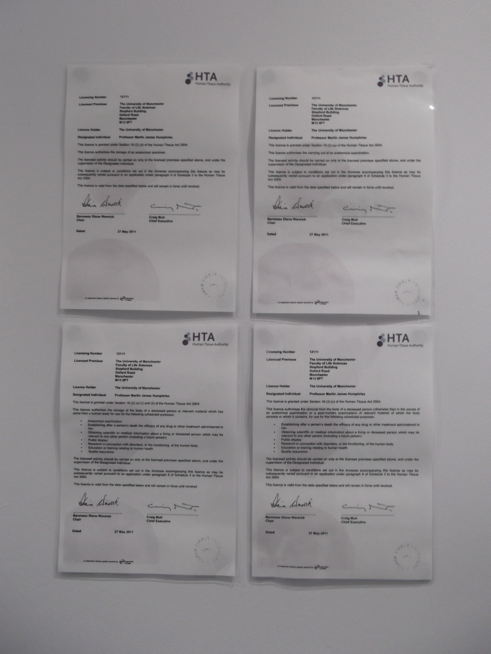
Manchester University Anatomy Licence
Displayed in the lobby of the DR
Permits us to
store anatomical specimens
carry out anatomical examination
Activities must take place on licensed premises under supervision of a Designated Individual (DI)
Failure to comply with the Human Tissue Act could result in the licence being revoked

Slide 8
Designated Individual (DI)
Must ensure that
the other persons to whom the licence applies are suitable persons to participate in the carrying-out of the licensed activity
that suitable practices are used in the dissecting room
that the conditions of the licence are complied with

Slide 9
How does the Human Tissues Act affect you?
You are a Persons to whom the licence applies
You must follow the strict code of conduct when using the DR
Failure to do so will result in disciplinary procedures and possible exclusion from the dissecting room

Slide 10
Code of conduct
Read and sign the eform before attending you’re dissecting room session week beginning 09/10/23
Go to 1med Learn
→ Year One
→ Introduction, Essential Skills & Study Skills
→ MBChB Programme induction
→ Anatomy – Introduction to Anatomy & Code of conduct
→ Page 5
Read code of conduct, at the bottom you will see
YOU MUST NOW COMPLETE THE CODE OF CONDUCT HERE BEFORE ATTENDING THESE SESSIONS
Click on the word HERE and you will be directed to eForms and asked to agree to the code

Slide 11
Code of conduct – main points
Access to DR limited, do not bring anyone in
Conduct yourself with decorum and respect
Do not remove any specimen from the DR
Do not take photographs
Mobile phones, personal iPads, cameras are not allowed in the DR
Do not discuss the DR on social media
Dress code – labcoat, dress respectfully, long hair should be tied back, no open toed/open backed shoes

Slide 12
Your studies in the DR
Weekly session in the DR
Doors will be opened 5 minutes prior to start time.
Place outdoor clothes, bags & mobile phones in lockers and change into your lab coat before class starts. - You will need £1 coin for the locker
Clinical fellow will mark you present as you enter the DR
It is your responsibility to ensure the you have been marked in- this cannot be done retrospectively
If you are late you will not be allowed to sign in and will be marked absent
During the session you will rotate around three stations with a clinical fellow

Slide 13
Today’s visit to DR
Today you will be taken to the DR and shown the lockers and procedure that you will follow. Start session by going over code of conduct
Three stations in the DR (10 mins per station)
Examples of prosections/models/potted specimens
Anatomical terminology – section planes, list of terminology
Cadavers – introduction to cadaver

